Slide 1
Does College Tuition Predict Salary Outcomes?
Anna Van Roekel
BAIS:3250 – Data Wrangling
Spring 2025

Slide 2
Introduction & Research Questions
Background
College tuition costs have risen sharply
Students want to know if higher tuition leads to higher salaries
Research Questions
Does higher tuition correlate with higher salaries?
Does graduation rate predict salary outcomes?
Are there regional differences?

Slide 3
Data Sources and Cleaning
Datasets Used:
CollegeTuitionCompare
College Scorecard API
Key Cleaning Steps:
Fuzzy match school names
Remove commas, $ signs, %
Convert SAT/ACT scores, graduation rates, and acceptance rates to numeric
Merge into one clean dataset (100+ colleges)

Slide 4
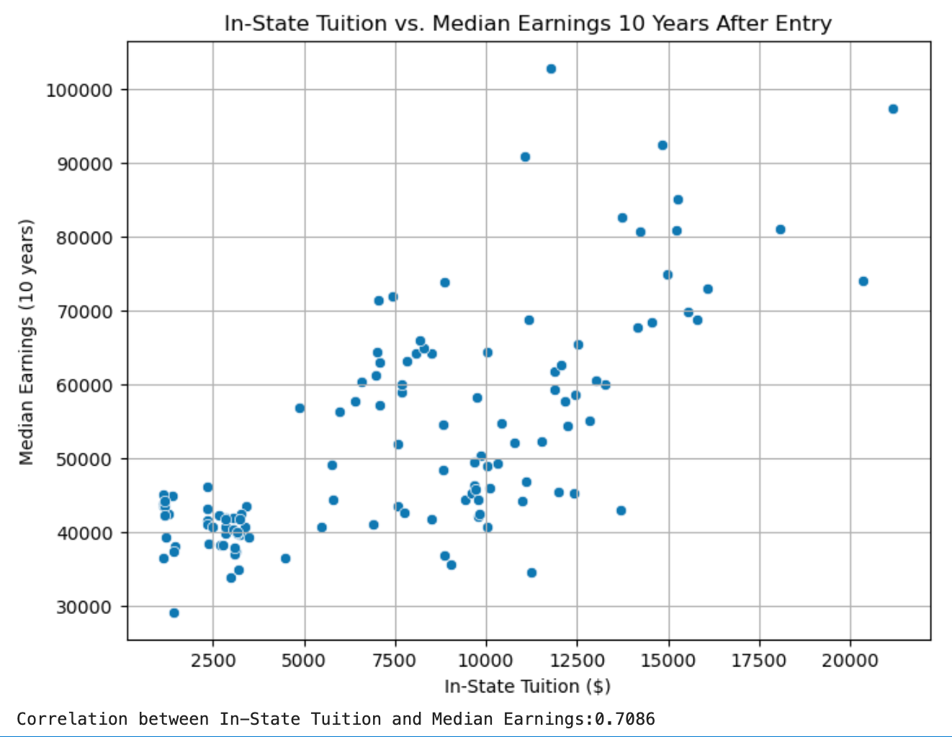
Initial Analysis Results: Tuition vs. Earnings
Correlation:
Tuition and salary are moderately positively correlated (~0.71)
T-Test:
p-value ≈ 0.00 → Significant difference between high and low tuition schools
Linear Regression:
Tuition explains ~50% of salary variance (R² = 0.50)

Slide 5
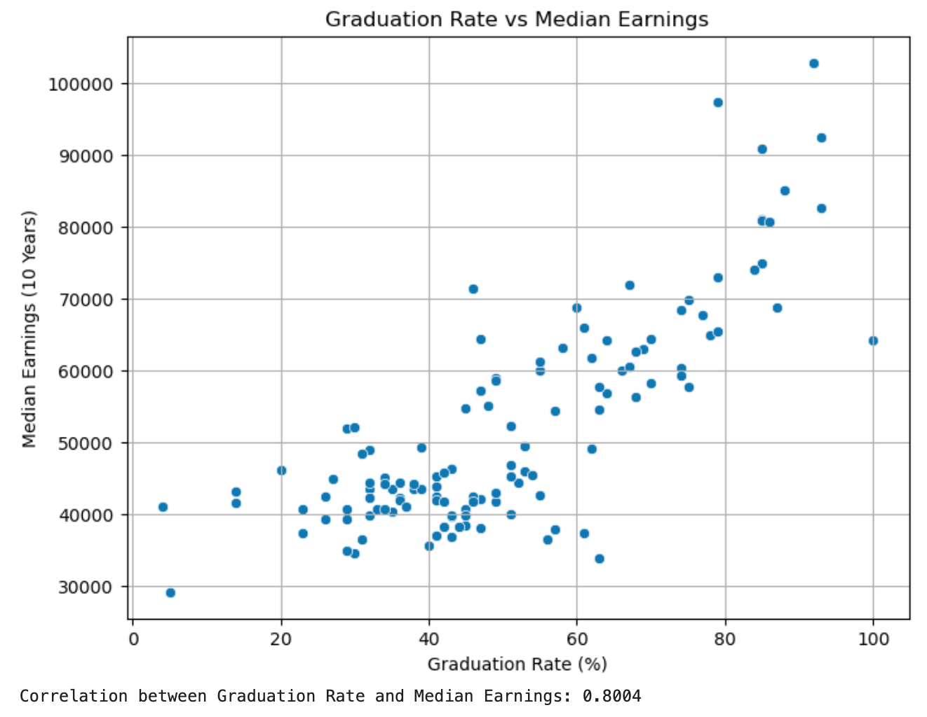
Initial Analysis Results: Graduation Rate vs. Earnings
Correlation:
Strong positive relationship between graduation rate and salaries
Insight:
Graduation rate may predict financial outcomes better than tuition

Slide 6
Machine Learning + Hypothesis Test
Machine Learning:
Linear regression modeling on tuition → earnings
Hypothesis Testing:
T-test confirmed high-tuition colleges have significantly higher graduate salaries
Next:
Expand model to include multiple features (graduation rate + tuition)

Slide 7
Roadmap and Challenges
Challenges:
Scraping the data
Matching school names across datasets
Dealing with missing/odd values in scores
Next Steps:
Answer regional differences question
Build multiple regression model (more predictors)
Finalize visualizations and interpretations

